Slide 1
Voice Biometric Authentication using Python
Prepared by:
Krishna Gupta (077BME019)
Shreyas Shrestha (077BAS041)
Submitted to:
Samsung Innovation Campus
IOE, Pulchowk Campus
Our Supervisors:
Basanta Joshi
Anila Kansakar
April 25, 2024

Slide 2
Protecting sensitive data
Preventing unauthorized access
Enhancing online security
Protecting intellectual property
Enhancing public safety
Security system and biometrics:

Slide 3
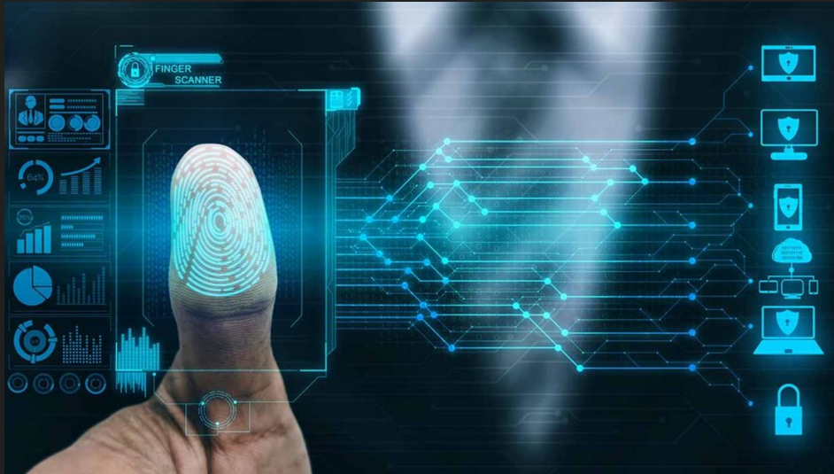
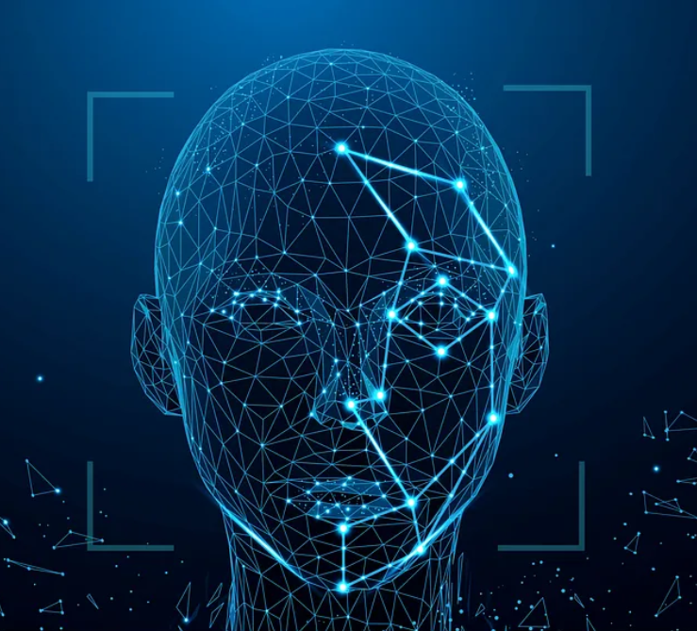
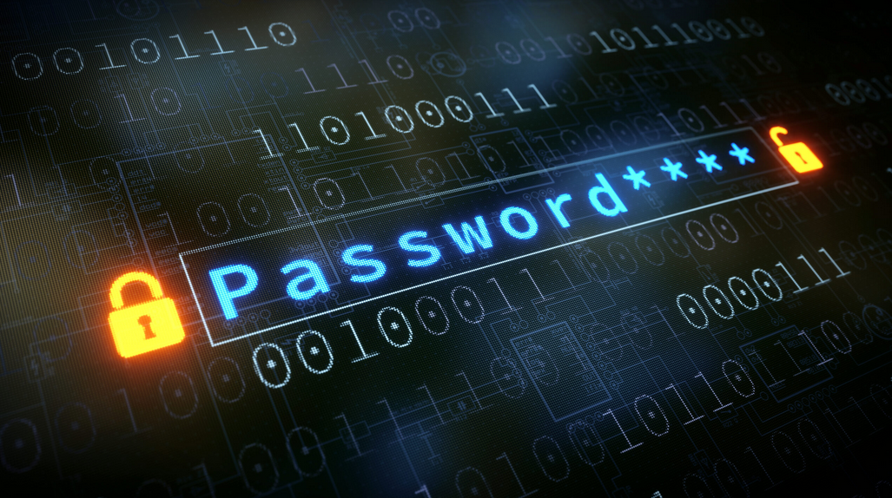
Commonly used security authentication:

Slide 4
Problems
Pin/Pattern
Credential Theft
Thumb
Risk of infection
Face recognition
Forget
Require minimum blind spots and clear angle shots

Slide 5

What can be alternatives?

Slide 6
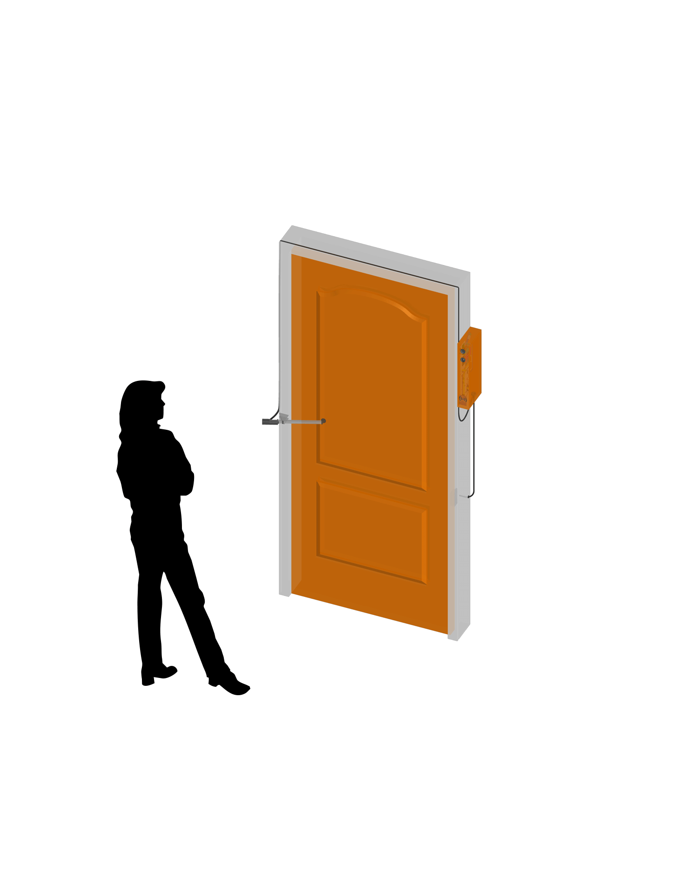
Voice biometric authentication:

Slide 7
Need for Secure Authentication:
-Vulnerabilities of traditional methods like passwords and PINs.
Voice Biometric Authentication:
-Offers a promising alternative by utilizing unique vocal characteristics for user verification
- Simpler and more convenient authentication experience

Slide 8
Project Objective:
-To develop a Python-based speech biometric authentication system that addresses technical challenges such as voice fluctuation and noise sensitivity, while enhancing security and usability.
Principle:
-Voice of a person is as unique as DNA

Slide 9
Methodology:
Recording the audio samples
Feature extraction using Mel-Frequency Cepstral Coefficients (MFCCs)
Model training with Support Vector Machine (SVM)
Testing and prediction

Slide 10
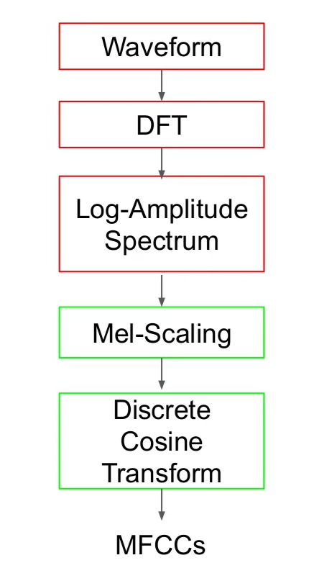
What is MFCCs?

Slide 11
Training:
Utilizes PyAudio for audio recording.
Extracts features using Librosa for MFCC (Mel-Frequency Cepstral Coefficients) calculation.
Processing includes standardization and SVM (Support Vector Machine) training with Scikit-learn.

Slide 12
Testing:
Recording and Predicting Authentication:
PyAudio is used for recording test audio samples.
Librosa is employed for feature extraction, specifically MFCC.
Scikit-learn's SVM model predicts authentication based on extracted features.
Visualization:
Waveform visualization using Matplotlib to display the amplitude over time.
Spectrogram visualization to depict the frequency content of the audio signal over time, aiding in authentication assessment.

Slide 13
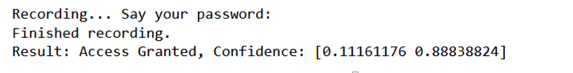
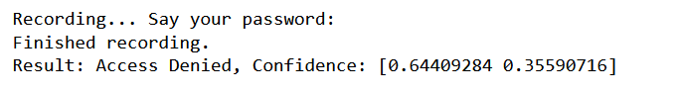
Testing:
When voice matches:
When voice does not match:

Slide 14
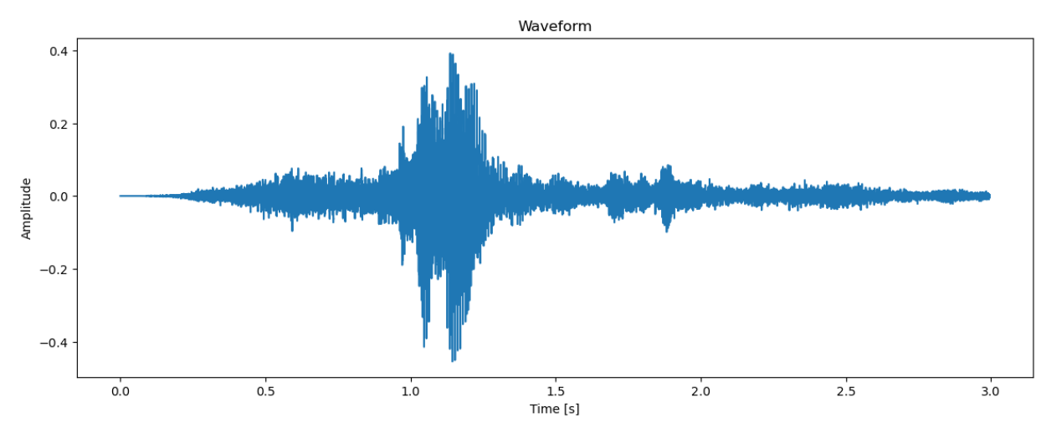
Data Visualization:
Fig : Test audio waveform

Slide 15
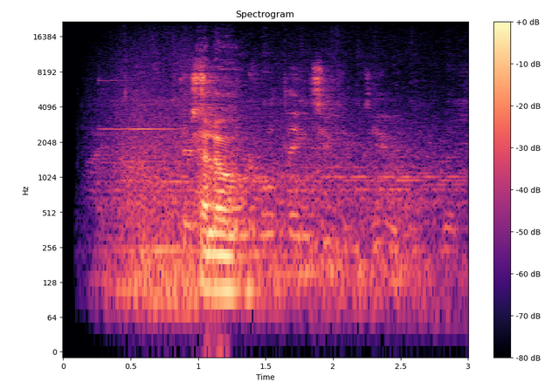
Data Visualization:
Fig : Test audio spectrogram

Slide 16
Results:
Able to recognize the voice of a person and grant the permission
Can be used as an integration with other authentication system

Slide 17
Future Enhancements:
Enhance noise reduction
Multiple speaker recognition
Higher number of sampling for better accuracy
Integration with other biometrics
Different keywords training

Slide 18
THANK YOU !!!
Any Query??

